Slide 1
Deep reservoir computing: A critical experimental analysis
ISPR - Midterm 4
Claudio Gallicchio, Alessio Micheli, Luca Pedrelli
Edoardo Federici - 616667

Slide 2
Necessary background

Slide 3
RNN for temporal data
Hierarchical Processing
Represent dynamical features at multiple levels of abstraction
Stack of recurrent layers ≡ set of constraints on a fully-connected RNN
Reservoir Computing: investigate architectural factors of deep models in a decoupled fashion wrt the learning aspects of the dynamical part
Stacking layers of recurrent units inherently creates different time-scales dynamics at different layers

Slide 4
Questions investigated

Slide 5
Why stack recurrent layers imposing constraints with respect to a full-connected RNN in favor of a layered deep organization?
What is the inherent (independent from learning) architectural ef-
fect of layering on the hierarchical temporal dynamics developed
by a deep RNN?
Is it possible to keep the advantage of Deep Learning for RNN (e.g. in terms of multi time-scales representation of temporal data) by using an efficient approach such is RC?
What is the role of the hyper-parameters that rule RC network dy-
namics within a layered organization of the reservoir?

Slide 6
Four architectures

Slide 7
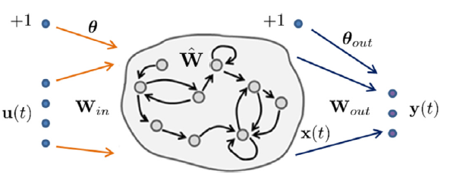

Shallow LI-ESN model
100 fully connected units
Both in this and in the following three models, there are two important hyper-parameters that will be tuned accordingly in each experiment:
leaky parameter 𝛼: regulates the speed of reservoir dynamics in response to the input.
spectral radius 𝜌 (of the recurrent weight matrix): regulates the variable memory length and the contractivity degree of reservoir dynamics.

Slide 8
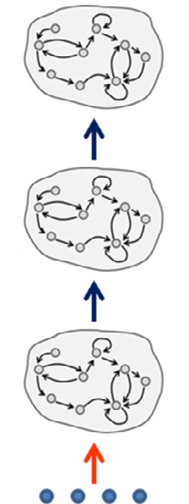



Deep ESN
10 layers of 10 fully-connected units

Slide 9
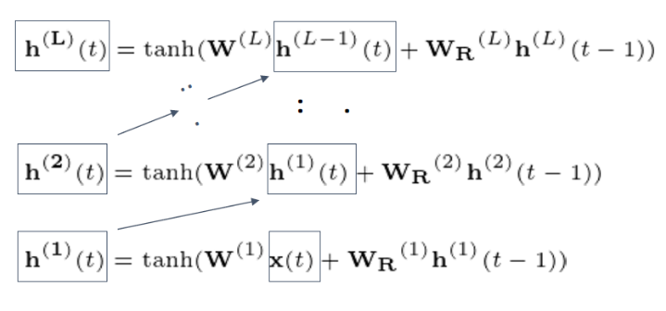
Deep ESN

Slide 10
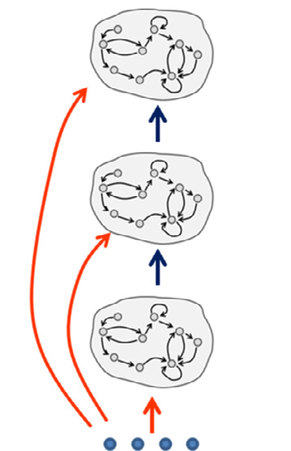

Deep ESN-IA
10 layers of 10 fully-connected units

Slide 11
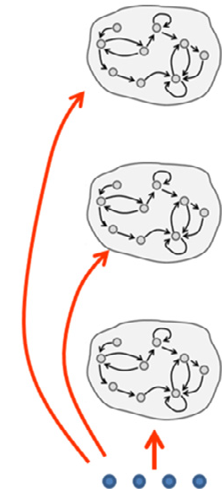

Grouped ESN
10 sub-reservoirs of 10 fully-connected units

Slide 12


Intrinsic Plasticity
With the goal of maximizing the entropy of the reservoir units output distribution, the IP rule implements a gradient descent algorithm that adapts the gain (g) and bias (b) parameters of the activation function locally to each reservoir unit.
When using the hyperbolic tangent as activation function, the IP rule aims at the minimization of the Kullback–Leibler divergence between the empirical output distribution and a target Gaussian distribution.
Focusing the attention on a single reservoir unit, the tanh nonlinearity can be expressed as
Accordingly, the IP rule is described by the following equations
where μ and σ denote the mean and standard deviation of the target Gaussian distribution.
The update is applied individually to each unit in the reservoir.

Slide 13
Datasets & Metrics

Slide 14
Two datasets
An artificial time-scales dataset, hand designed, in which each input element is drawn from a uniform distribution from an alphabet of 10 elements.
An adaptation of an excerpt of the Wikipedia text corpus, where the alphabet is comprised of the most common 95 common characters + 1.
For each experiment, two input sequences were fed to the RC models: S₁ and S₂, both of length 5000 and identical to each other except for a perturbation.
Goal: evaluate how long the effect of the input perturbation affects the dynamics of each layer.
How: compute the distance between the states corresponding to S₁ and S₂ as a function of time.
Notes:
REORDER

Slide 15
Three metrics
A quantitative analysis is presented for both datasets, by measuring the time-scales diversification according to the following metrics:
Kendall’s Tau (KT) and Spearman’s Footrule (SF) measure the distance between rankings of layers (ordered according to the duration of the perturbation effect); smaller values denote better orderings of time-scales.
Index of Separation (IS) instead quantifies the extent of time-scales separation by measuring the distances between the duration of the perturbation in consecutive layers; higher values correspond to greater spacing among the duration of the perturbation effect in the different layers.
For the artificial dataset a qualitative analysis is also presented, by plotting the Euclidean distance between the states of corresponding layers in S₁ and S₂.
The curves for each layer and the metrics values are evaluated on 10 independent guesses and averaged.

Slide 16
Experimental analysis

Slide 17
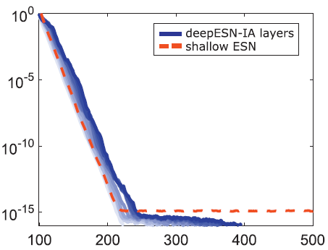
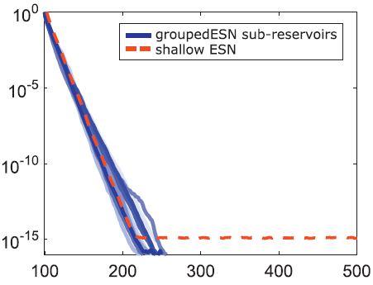
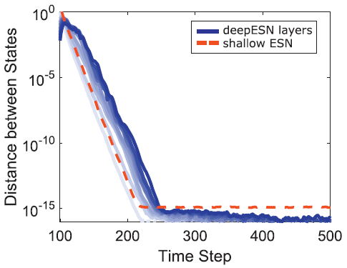
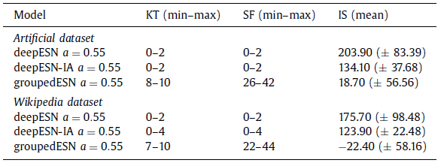
Time-scales differentiation:
Intrinsic architectural properties
Fixed (non optimized) values for 𝛼=0.55 and 𝜌=0.9 among the layers.
Observation: the effects of input perturbation last longer for higher layers in the stack (and for further layers from the input).

Slide 18
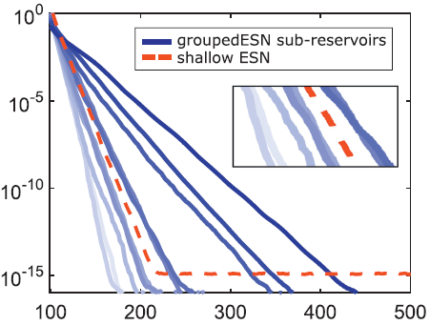
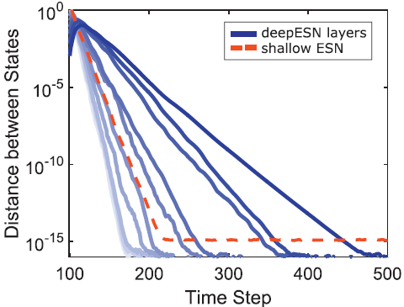
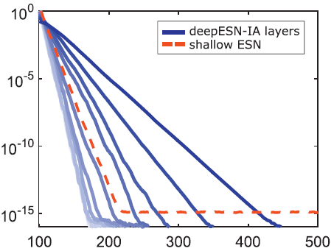
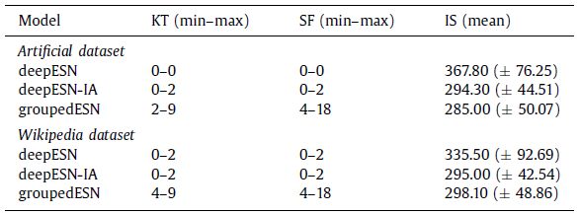
Time-scales differentiation:
Hyper-parameters
𝜌=0.9 and decreasing values of 𝛼 for increasing layer depth (progressively slower speed of reservoir dynamics at higher layers).
Observation: interplay between layering and leaky integration variability. Similar results with fixed 𝛼 and decreasing 𝜌.

Slide 19
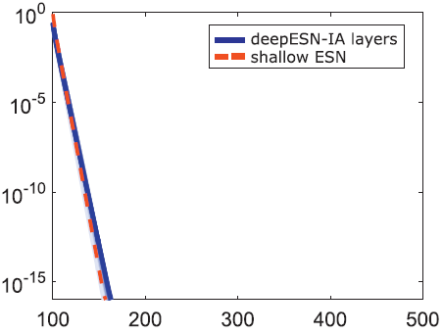
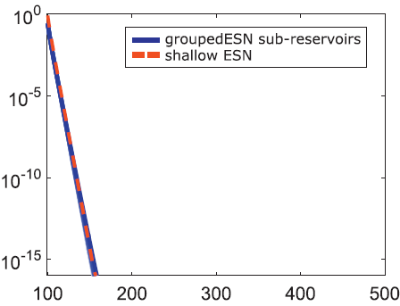
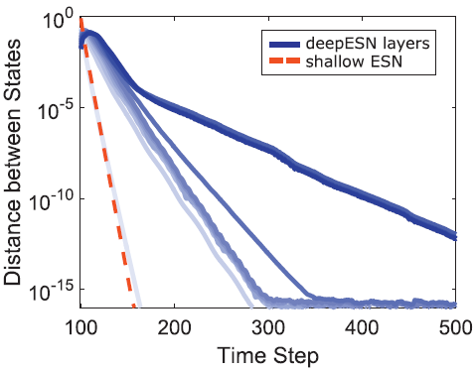
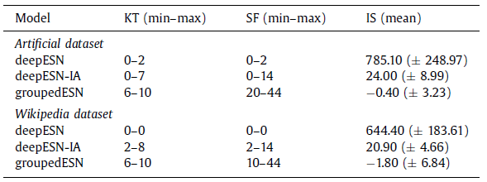
Time-scales differentiation:
IP training
Fixed (non optimized) values for 𝛼=0.55 and 𝜌=0.9 among the layers and IP learning (μ=0, σ=0.1, η=1e⁻⁵).
Observation: higher layers forget slowly the past input history; increasing IP effectiveness among the layers (diversification of the memory length in different layers: “changing the gain of tanhs” ~ “changing 𝜌 at different layers”).

Slide 20
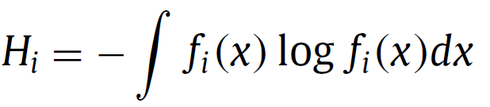
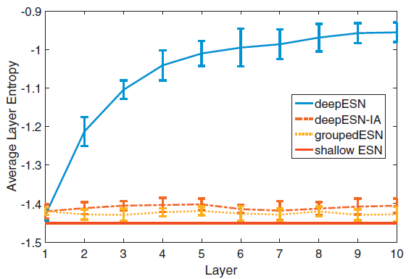
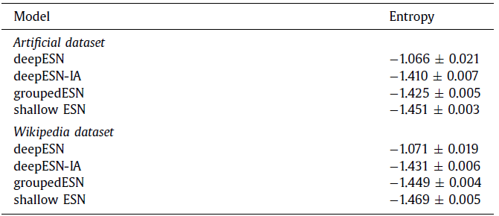
Richness of reservoir dynamics:
IP training and layering
Entropy of reservoir units activation over time (interpreted as richness of state dynamics):
Fixed (non optimized) values for 𝛼=0.55 and 𝜌=0.9 among the layers and IP learning (μ=0, σ=0.1, η=1e⁻⁵).
Observation: IP improves entropy for DeepESN.

Slide 21
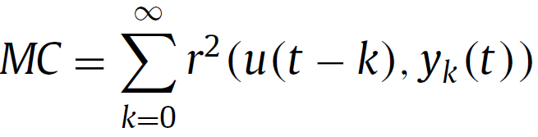
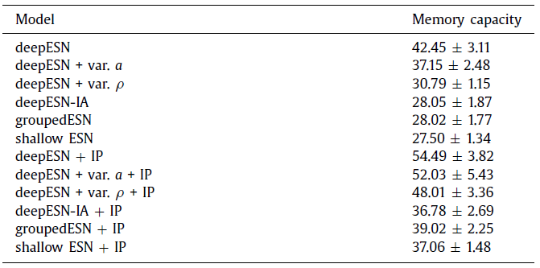
Short-term memory capacity
Short-term Memory Capacity of RC networks (evaluating how well it is possible to recall delayed versions of the input based on reservoir activations):
Task: reconstruct the input stream with increasing delays
Grid search for 𝛼, 𝜌, IP (μ=0, σ=(0.1, 0.01), η=1e⁻⁵) on/off.
Observation: deepESN obtained the best MC both without IP and with IP, improving the results obtained by shallow ESNs

Slide 22
Conclusions

Slide 23
Depth isn’t everything, but matters
The variability of parameters of reservoir design ruling the speed of dynamics in response to the input (𝛼) and the memory length (𝜌) could effectively amplify the emergence of multiple (separated) time-scales, hierarchically ordered across the layers of a deepESN.
On top of this, an unsupervised adaptation of (only) the parameters of the reservoir activation functions (IP) has shown great impact.
The deepESN architecture allows to improve the short-term memory capacity with respect to the shallow case.
The effect of IP learning on the MC task is greatly exalted by the use of a layered architecture.

Slide 24
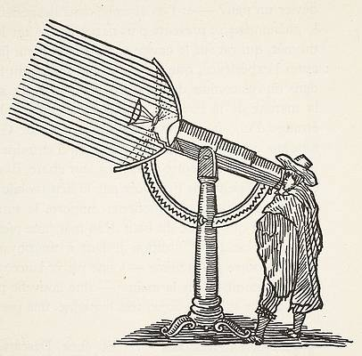
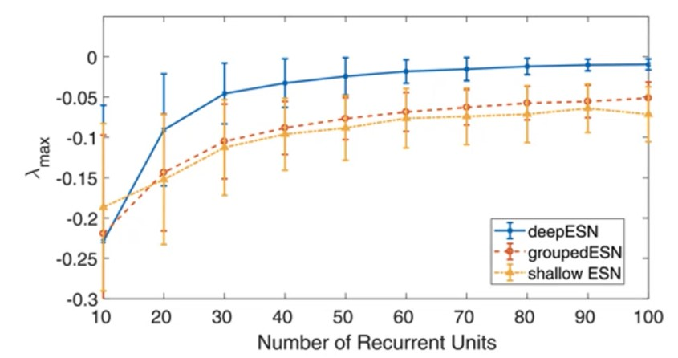
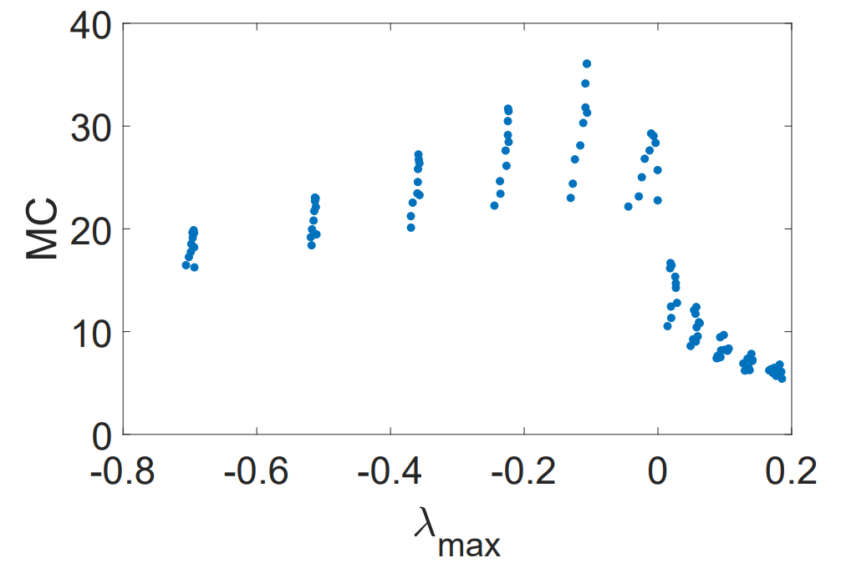
Looking ahead
We can try to set up new learning models boosted by an enriched representation of the input dynamics, exploiting the time-scale differentiation developed through the layers to solve complex tasks that require/involve processing time-series data at different levels of time granularity.
Gallicchio, C., Micheli, A. and Silvestri, L., 2018. Local lyapunov exponents of deep echo state networks. Neurocomputing, 298, pp.34-45.
Notes:
STABILITY: LYAPUNOV EXPONENTS → 0 CHAAAAOOOOS
the spectral radius value represents an a-priori measure of the richness of reservoir dynamics that does not take into consideration the actual input on which the reservoir is run, whereas the spectrum of Lyapunov exponents has been considered as a more accurate way to characterize the reservoir dynamics

